Slide 1

Building Modern Mobile Apps – React Native
Kevin E Ford
Mobile Practice Lead,
Magenic
Level: Introductory

Slide 2
Kevin Ford
KevinF@magenic.com
@Bowman74
http://windingroadway.blogspot.com
https://github.com/Bowman74
BrentE@magenic.com
@brentledwards
http://www.brentedwards.net
https://github.com/brentedwards
Brent Edwards

Slide 3
Mobile Tasks Source Code
GitHub
https://github.com/brentedwards/MobileTasks

Slide 4
What is REACT Native Development?

Slide 5
React Native History
First public Preview Jan 2015
Made Open Source March 2015 ***
Open source UI toolkit released Sep 2016
0.49 released Sep 2017
Notes:
Is it fully open source

Slide 6
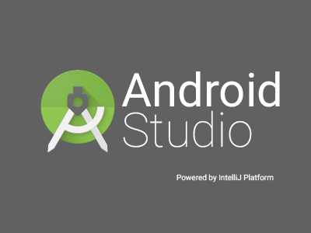
IDEs

Slide 8


Supported Platforms?
Notes:
Android 2.3.3 and later (4.4 provides the best developer experience)
iOS 6, 7, and 8
Windows 8 and 8.1
Windows Phone 8 and 8.
Windows Universal

Slide 9



What do I need?
Notes:
This stuff is installed for you.

Slide 10
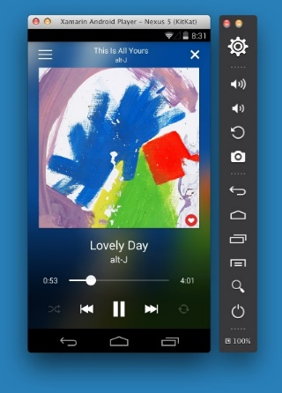
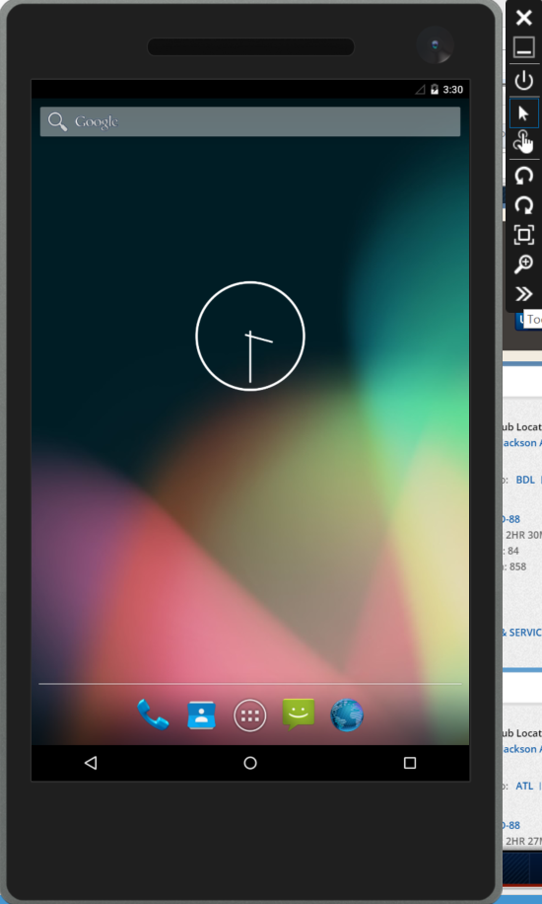
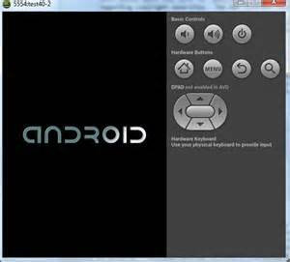
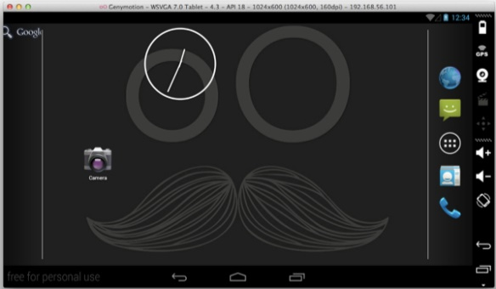
Emulator Options - Android

Slide 11
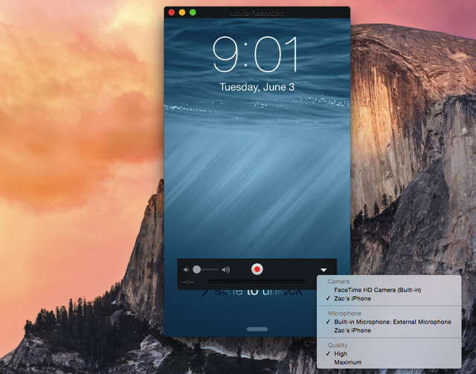
iOS

Slide 12
Preview Version
React Native is currently version 0.49

Slide 13
How does the UI work?
It’s only JavaScript
No HTML
No CSS
Uses proprietary styling technology
UI itself may be platform specific
Many platform specific React Native controls
Different than React for the web
Notes:
“Fluid Experiences”
Picture-in-Picture
A familiar phrase and tool in many televisions, within the YouTube app on Android and, yes, in iOS. Google is adding a Picture-in-Picture mode to Android O. With a YouTube video playing, just tap the Home button and the video will pop into a small window that can remain on screen as you navigate other apps on your device. You can slide the video around for best placement, then simply slide it off the screen to terminate. Available now in the Android O Beta.
Notification Dots
Many custom Launcher users already know the power of a notification icon on top of an app icon on your Homescreen. We even used Tasker to build our own once, but now Google is building it into Android. Android O users will see a small dot that appears over top of their app icons with active notifications. This is where the magic starts, now that your app has an icon, new tools are available – Long-press the app icon with Notification Dot to get a short list of immediate shortlink actions you can perform. This includes viewing the notification itself right there in a tiny pop-up window.
Auto-Fill
For your most used apps on your device, Android O will help quickly log into services. The Auto-Fill feature needs to be coded in by the app devs, but once installed, Android O will remember your usernames, and in some cases your password, to quickly and easily jump into apps on your device.
Smart Text Selection
We’ve all seen the basic text highlighting features, the copy/paste dialogue in Android, but now there’s more. With Android O, highlighting text includes further features, using Google AI to intelligently act on the words. For instance, if you highlight a phone number, you can just tap to dial. If you highlight an address, a single tap will start navigation. Best of all, highlighting is more intelligent itself, selecting phrases or full addresses, for example, instead of just single words.

Slide 14
What is Really Shared?
The language – mostly
Entry points are per platform
Can tie into shared code
The most efficient UIs use platform specific components
Access to native APIs in many cases will need to be platform specific

Slide 15
What is a ‘Native Module’
Allows access to underlying native APIs
With this features of newer versions of the OS can be accessed quickly
Not dependent on waiting for the React Native team
Written in JavaScript, but still need knowledge of underlying native APIs and platforms
Can be used to access platform-specific native code (i.e. Objective-C/Java)
Notes:
In the future, all version of Android are going to ship with an Android Go variant. As Android becomes more powerful, Android Go seems like a smart move to make it run on crazy cheap phones and slow networks.
Partners such as Facebook and Microsoft with Skype have already shipped versions of their apps that are optimized for Go devices. Other apps that are optimized for Android Go will be featured in a new section on the Play Store that are specially indicated to be “optimized for your device.” Developersof any application can learn to optimize their device for Android Go by visiting this new page dedicated to getting your app in the hands of billions.

Slide 16
Can Code be Shared with Website?
Server side code can be easily shared, with native or React Native projects
Most performant solutions require per platform UI
Complex / new API integration will require platform specific modules
Frameworks like Angular can help
Separation of concerns are key
Differences in app features
Generally it is the code below that UI that has the greatest possibilities to be shared
Notes:
In the future, all version of Android are going to ship with an Android Go variant. As Android becomes more powerful, Android Go seems like a smart move to make it run on crazy cheap phones and slow networks.
Partners such as Facebook and Microsoft with Skype have already shipped versions of their apps that are optimized for Go devices. Other apps that are optimized for Android Go will be featured in a new section on the Play Store that are specially indicated to be “optimized for your device.” Developersof any application can learn to optimize their device for Android Go by visiting this new page dedicated to getting your app in the hands of billions.

Slide 17
Code Sharing
React Native allows it
App needs to be designed appropriately
More code sharing = more compromises
Native does not
With different languages it is a non starter
API code can be shared in both scenarios
Notes:
Growth in smart homes, wearables, and connected cars offer new ways for insurers to embed insurance in customers lives
11.6 billion mobile connected devices by 2020
50 million smart home devices by 2021
$156 billion connected car services market by 2022
Consumers: willingness to experiment, straddle the physical and digital worlds and share information
Independent agents: developing their own digital solutions, with online propositions that look increasingly like those of direct carriers

Slide 18
Performance Considerations with React Native
CPU intensive tasks
May have to be written in native code
Could be moved server side
React warns against some cross platform controls
Navigation
Native controls but not native UI performance
React Native requires increased scrutiny of performance

Slide 19
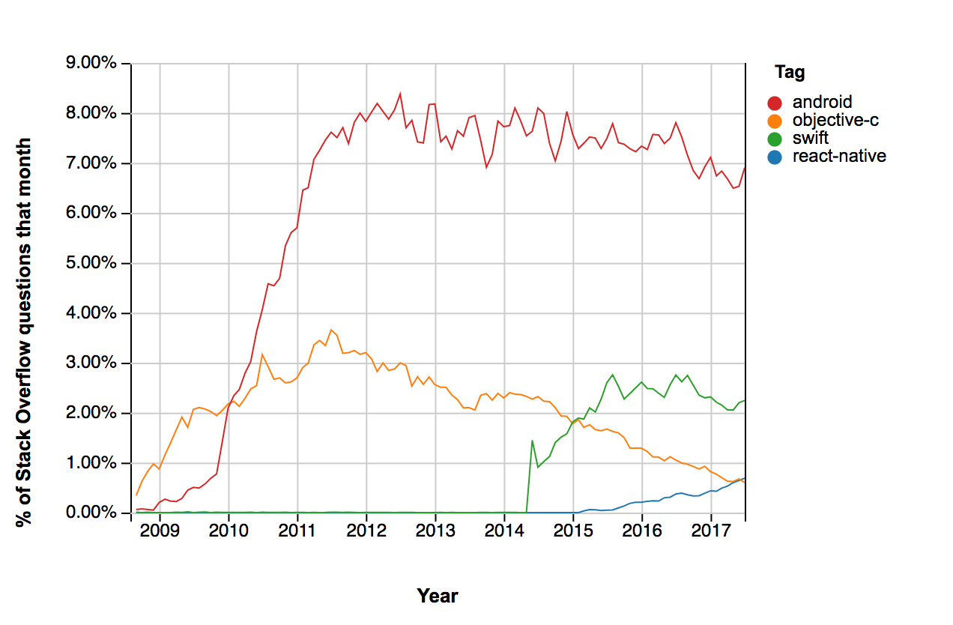
Community Support – Stack Overflow

Slide 20
React Native Limitations
Certain features are not available
Android Widgets
Some asynchronous scenarios
iOS Rich Push Notifications
SVG images
Generally geared around making the core app
Third party support may not be always be there
(for example Azure App Services authorization)

Slide 21
React Native Advantages
Deploy fixes without redeploying app
Care must be take with the iOS Store
Deploy test versions of the app to devices without an OSX machine (Expo)
Make code changes while running
Can run within a native application
Code and UX sharing

Slide 22
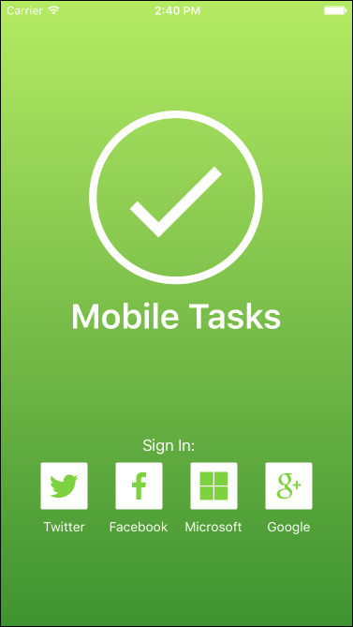
The UI
One written in Xcode
One using React Native
Which is which?
Tradeoffs: To be clear when hearing the term “pixel perfect” React Native may not deliver in complex scenarios

Slide 23
Connecting to Azure
No direct React Native Support
Support via native libraries
Add native modules in native code
Need to normalize interface

Slide 24
When to Use
Cost Primary Driver
Need a native UI but are willing to live within box
Need good but not pixel perfect UI
Need good but not native performance
Writing for multiple platforms

Slide 25
Conclusion
Fast way to Create X-Platform Apps
UI Compromises
Need to know native languages on occasion
Performance Compromises

Slide 26
Questions?

